Slide 1
Clearing the Skies: A deep network architecture for single-image rain removal
Xueyang Fu, Jiabin Huang, Xinghao Ding*, Yinghao Liao and John Paisley
Notes:
第一页

Slide 2
Abstract
we use image processing domain knowledge to modify the objective function and improve deraining with a modestly-sized CNN.
we train our DerainNet on the detail (high-pass) layer rather than in the image domain.
we augment the CNN framework with image enhancement to improve the visual results.
Notes:
第二页

Slide 3
Introduction
Our approach is to use a specialized convolutional neural network to predict clean patches, given dirty or clean ones as input.
we use image processing domain knowledge to modify the objective function and improve the de-rain quality.

Slide 4
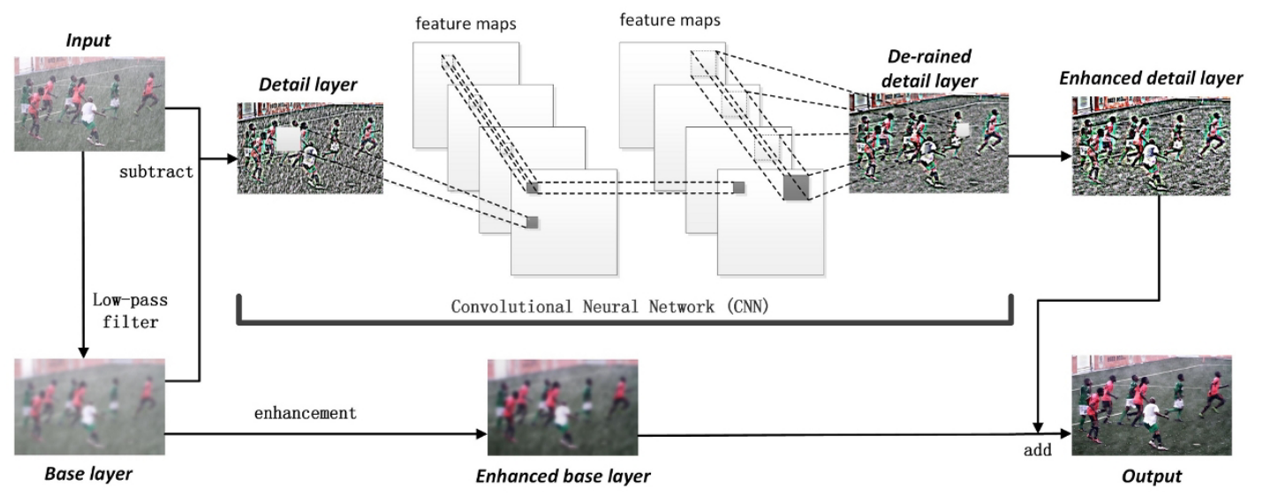
DERAINNET: DEEP LEARNING FOR RAIN REMOVAL

Slide 5
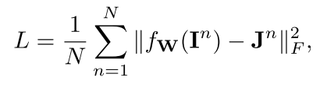
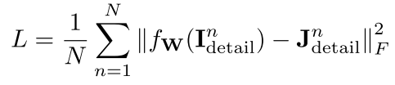


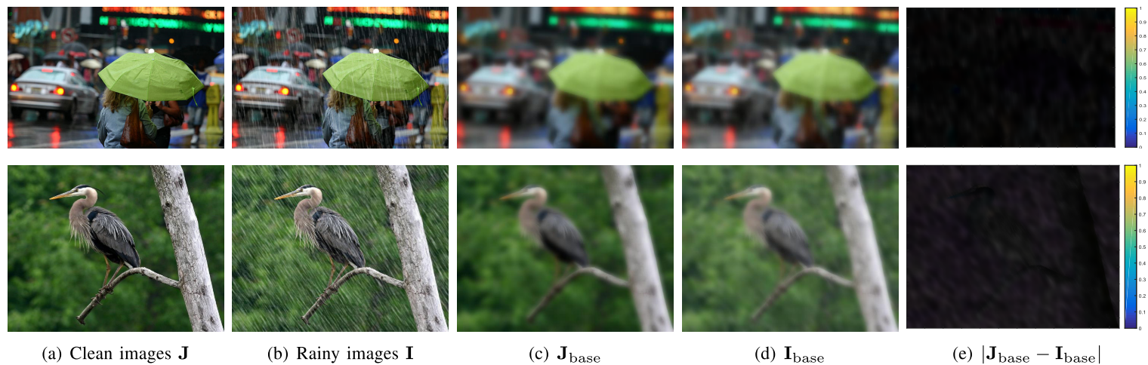
A.Training on high-pass detail layers:
Base model
Improvement

Slide 6
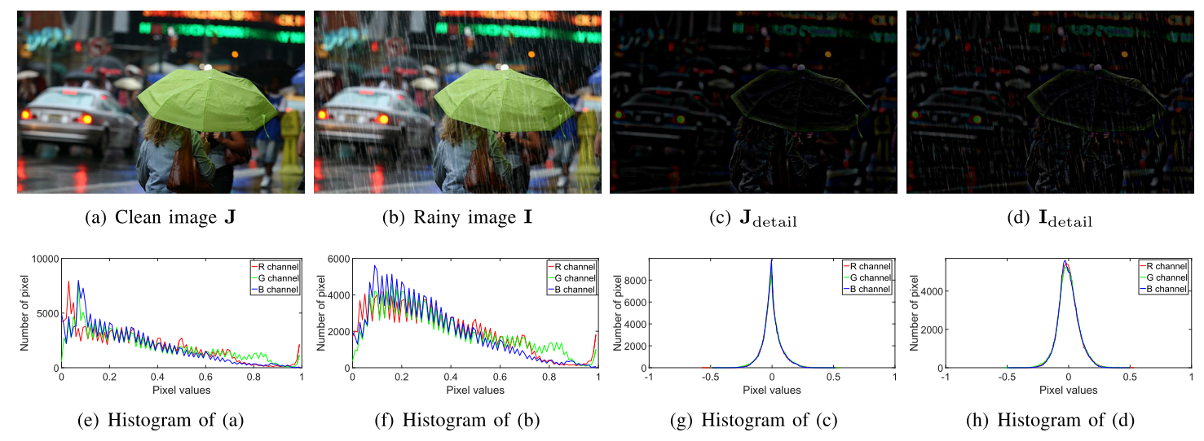
Detail image is more Sparsity than origin，so it’s easier to handel for CNN model

Slide 7
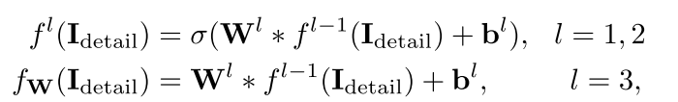
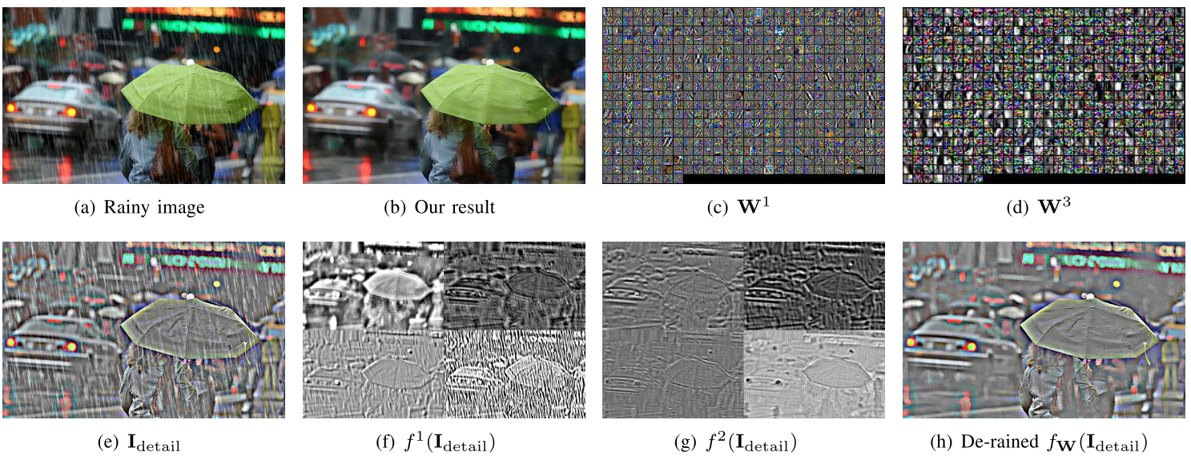
B.Our convolutional neural network

Slide 8
C.data
One picture with 14 different kinds，350 X 14 = 4900.
D.Combining CNN with image enhancement
Use non-linear function to enhance the base layer

